Slide 1
Stability
1

Slide 2
Specific Objectives
Importance of stability
Analyze different types of stability
Apply Routh’s stability criterion analysis and solve the numerical.
2

Slide 3
Stability
Introduction to Stability
Definition of Stability, Analysis of stable, unstable, critically stable
and conditionally stable
Relative Stability
Root locations in S-plane for stable and unstable system
Routh’s Stability Criterion
Routh’s Stability Criterion : Different cases and conditions
Statement Method
Numericals Problems
3

Slide 4
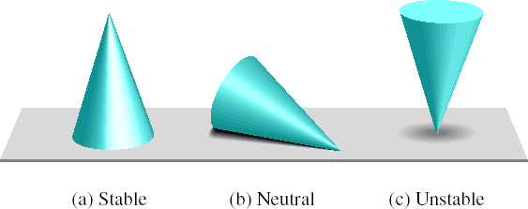
“Concept of Stability”
The concept of stability can be illustrated by a cone placed on a plane horizontal surface.
14

Slide 5
Stable System
A linear time invarient system is stable if following conditions are satisfied:
A bounded input is given to the system, the response of the system is bounded and controllable.
In the absence of the inputs, the output should tend to zero as time increases.

Slide 6
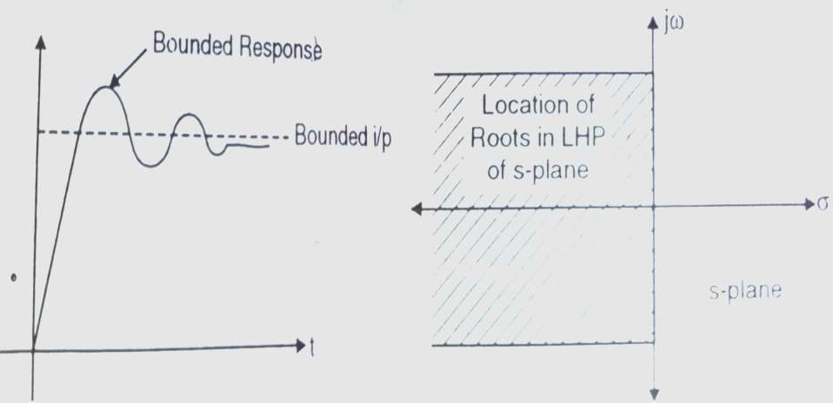
Stable System
Bounded i/p bounded o/p for stable system
Location of roots for stable system

Slide 7
Unstable System
A linear time invarient system comes under the class of unstable system if the system is excited by a bounded input, response is unbounded.
This means once any input is given system output goes on increasing & designer does not have any control on it

Slide 8
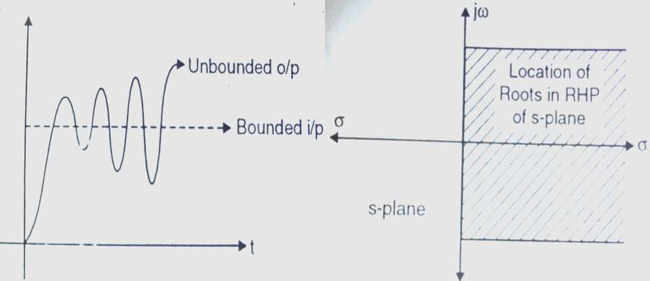
Unstable System
Bounded i/p Unbounded o/p for unstable system
Location of roots for unstable system

Slide 9
Critically Stable System
When the input is given to a linear time invarient system, for critically stable systems the output does not go on increasing infinitely nor does it go to zero as time increases.
The output usually oscillates in a finite range or remains steady at some value.
Such systems are not stable as their response does not decay to zero. Neither they are defined as unstable because their output does not go on increasing infinitely.

Slide 10
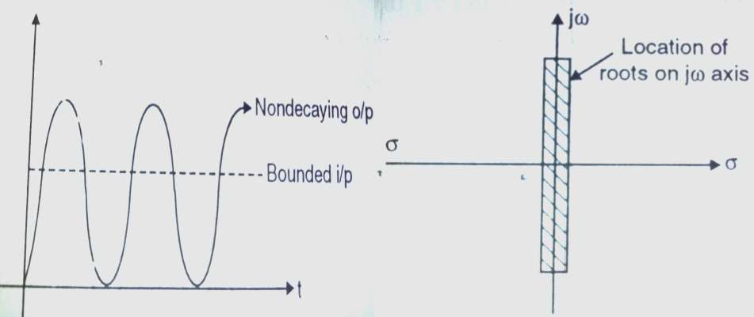
Critically stable System
Bounded i/p & o/p response for critically stable system
Location of roots
for critically stable system

Slide 11
Relative Stability
A system may be absolutely stable i.e. it may have passed the Routh stability test.
As a result their response decays to zero under zero input conditions
The ratio at which these decay to zero is important to check the concept of “Relative stability”

Slide 12
Relative Stability
When the poles are located far away from jw axis in LHP of s-plane, the response decays to zero much faster, as compared to the poles close to jw-axis.
The more the poles are located far away from jw-axis the more is the system relatively stable.

Slide 13
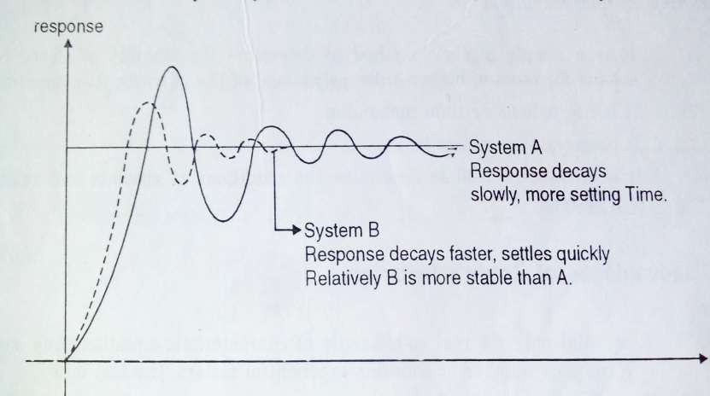
jω
Relative Stability
Location of poles comparison
×
×
−σ
σ
×
×
jω
System B Complex conjugate poles
System A Complex conjugate poles

Slide 14
Relative Stability
Response comparison

Slide 15
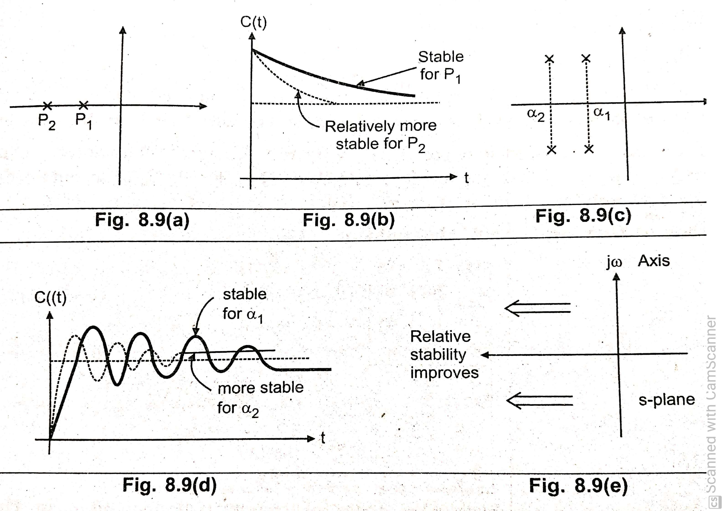

Slide 16
jω
Relative Stability
−σ
σ
Relative Stability improves as one moves away from jw axis
jω

Slide 17
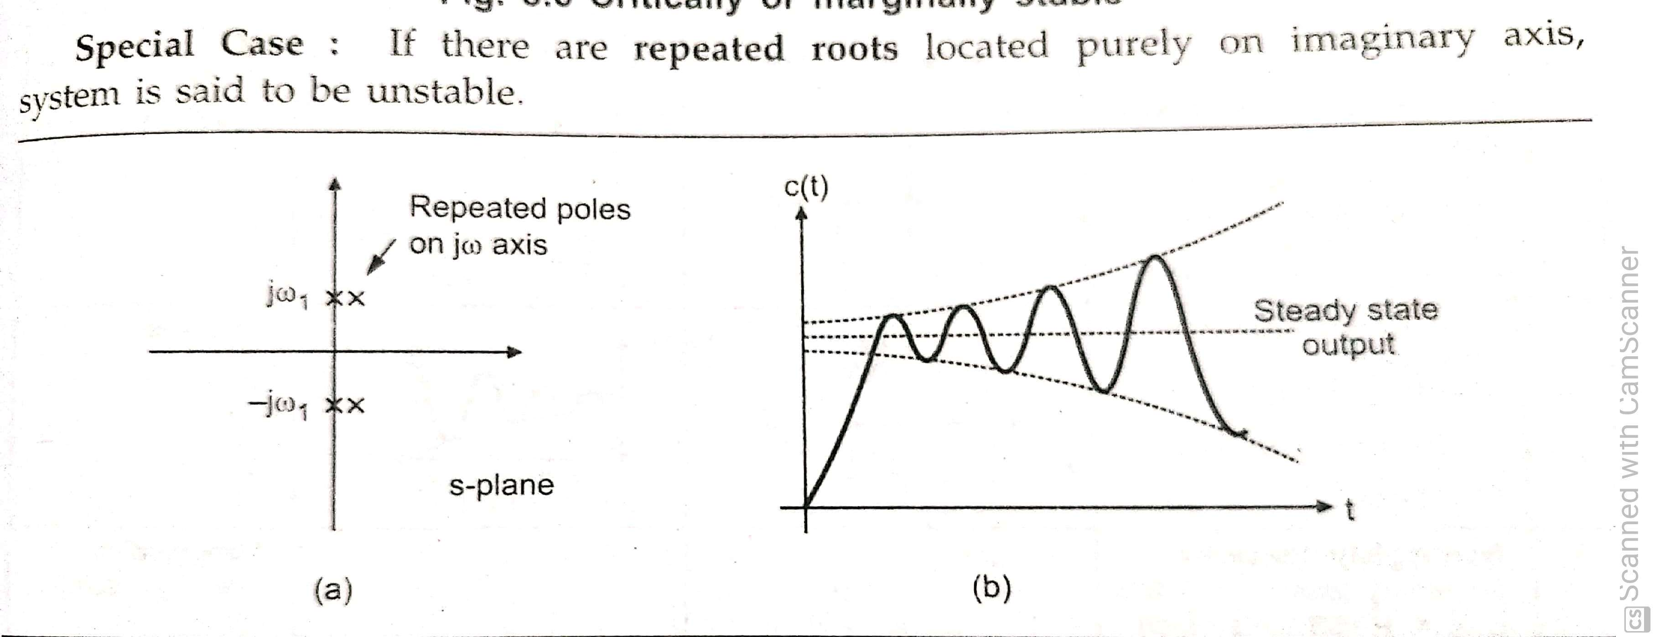

Slide 18
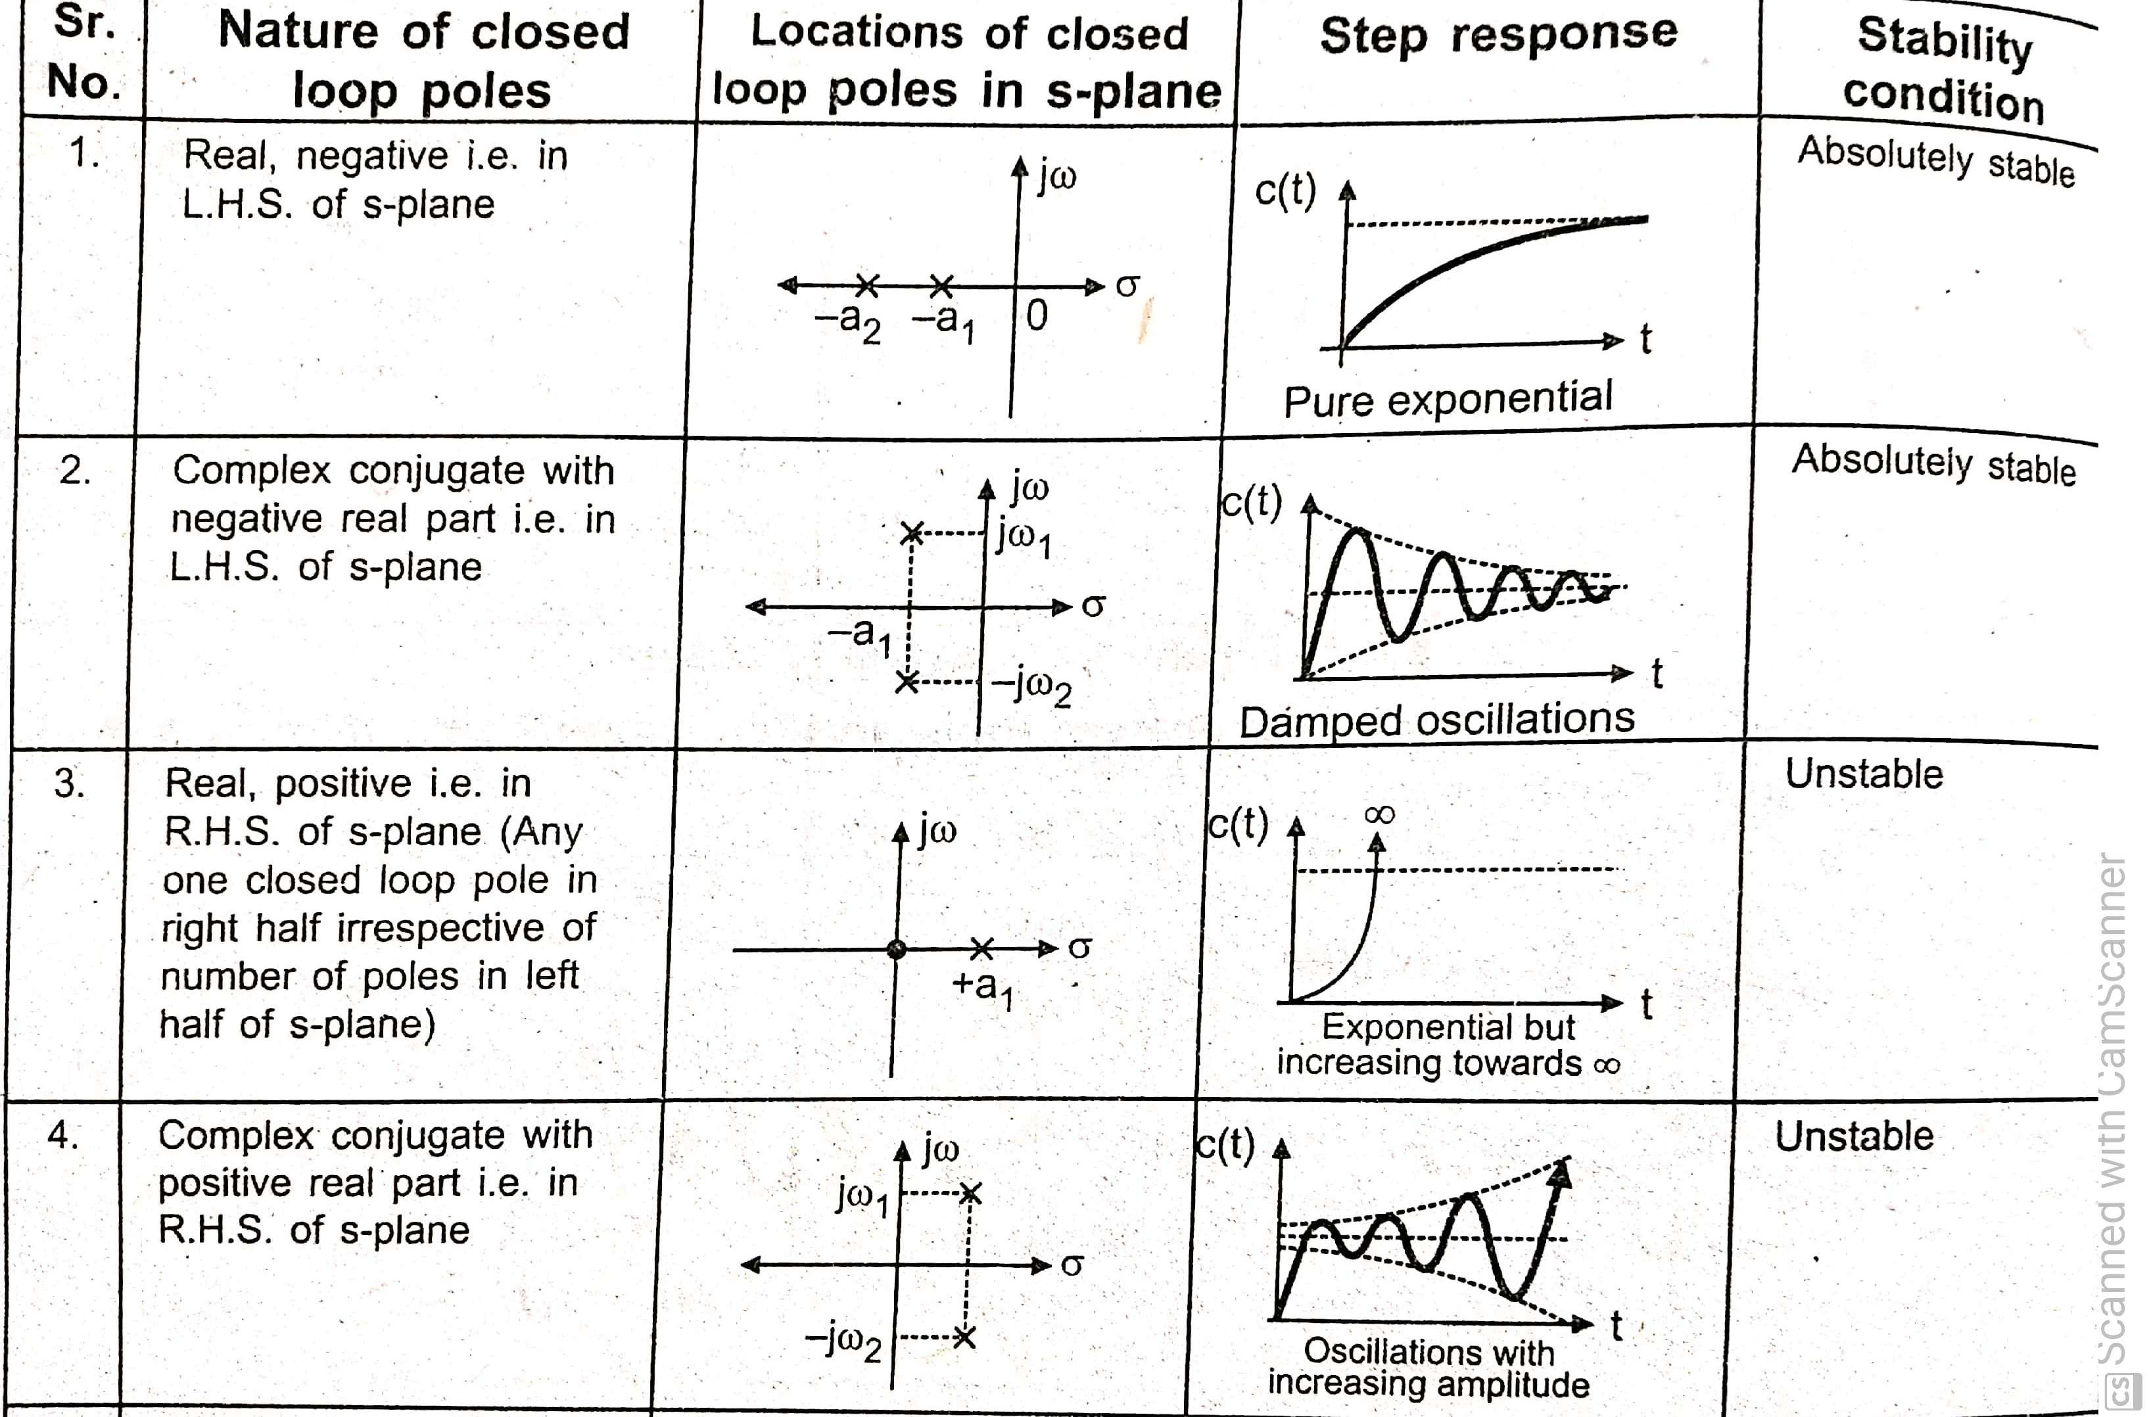

Slide 19
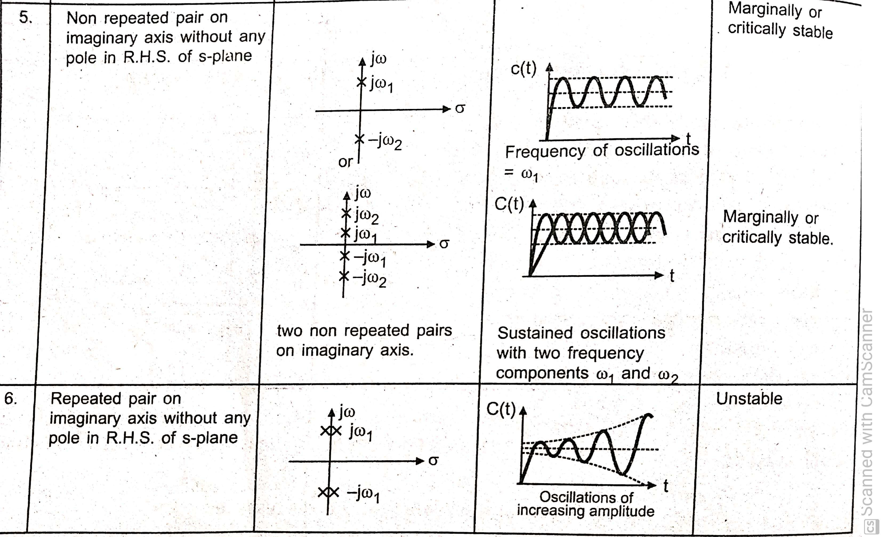

Slide 20
stability

Slide 21
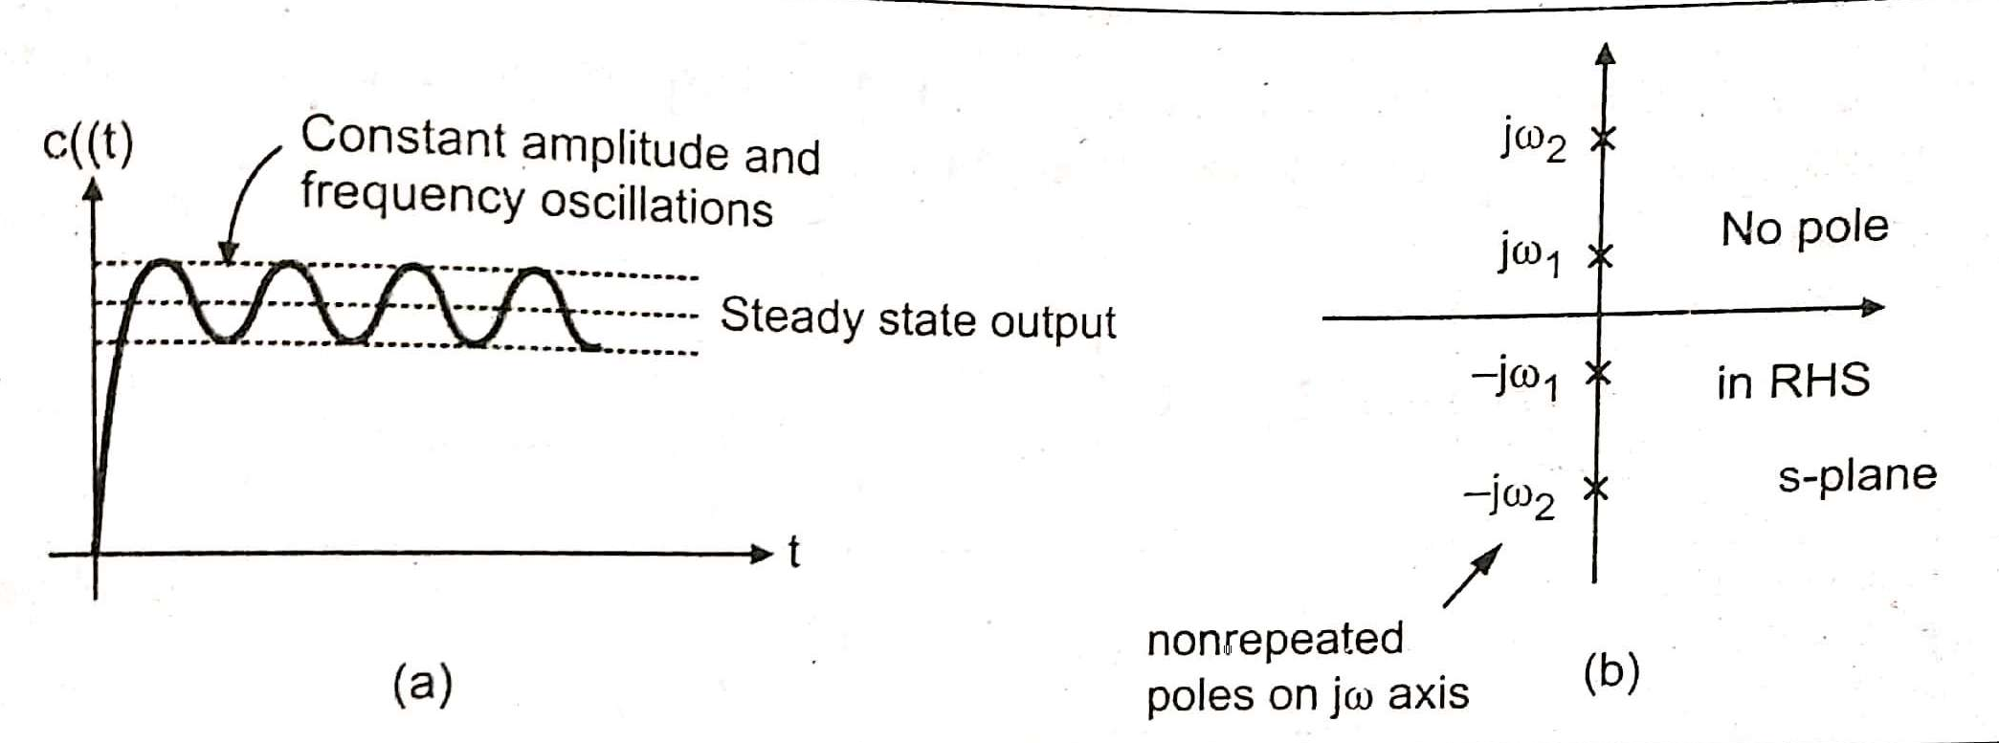

Slide 22
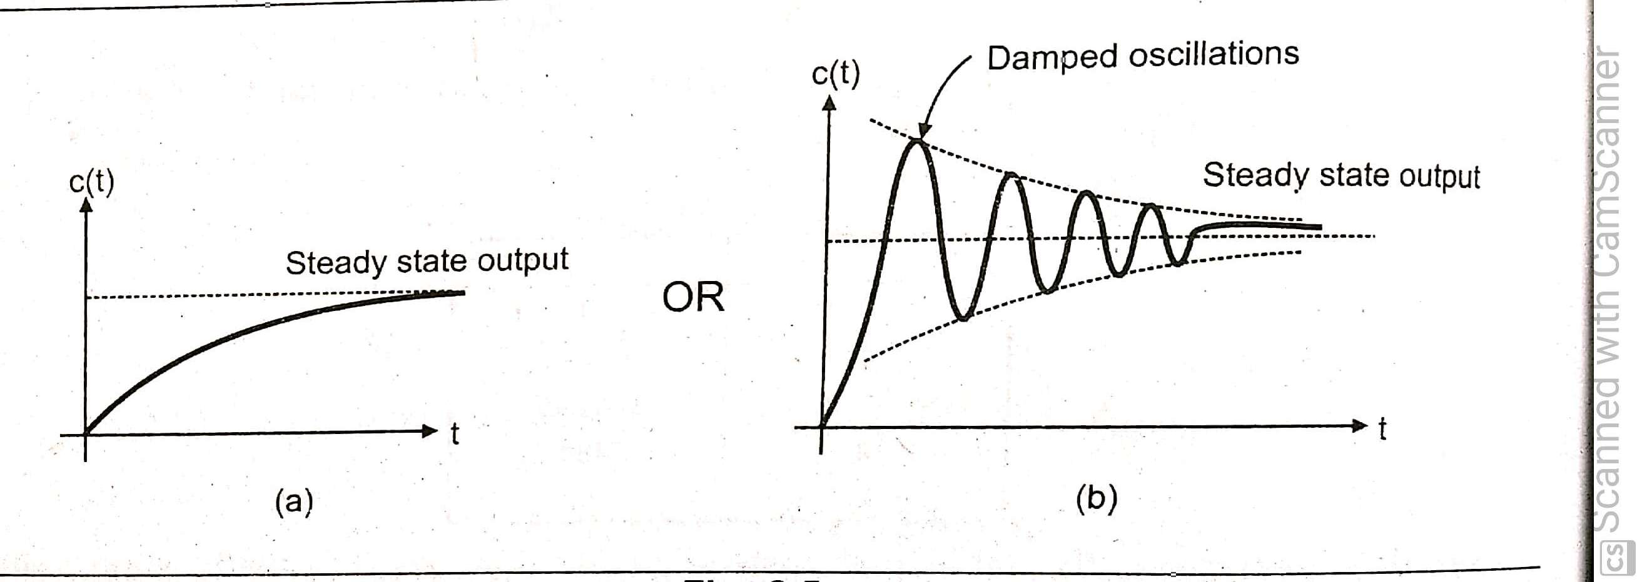

Slide 23
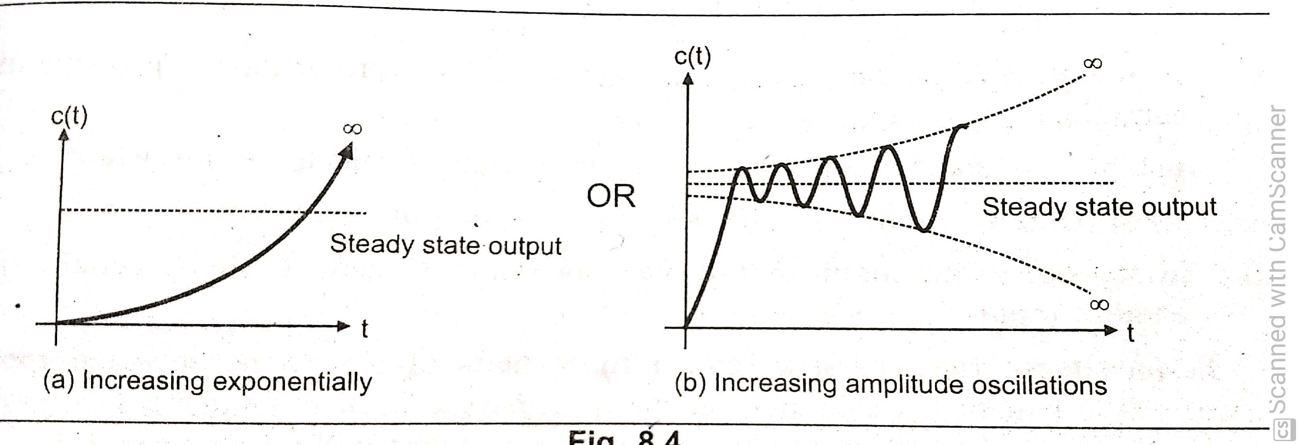

Slide 24
Stability
24

Slide 25
STABILITY
Importance of stability
Analyze different types of stability
Apply Routh’s stability criterion analysis and solve the numerical.
25

Slide 26
Stability
Introduction to Stability
Definition of Stability, Analysis of stable, unstable, critically stable
and conditionally stable
Relative Stability
Root locations in S-plane for stable and unstable system
Routh’s Stability Criterion
Routh’s Stability Criterion : Different cases and conditions
Statement Method
Numericals Problems
26

Slide 27
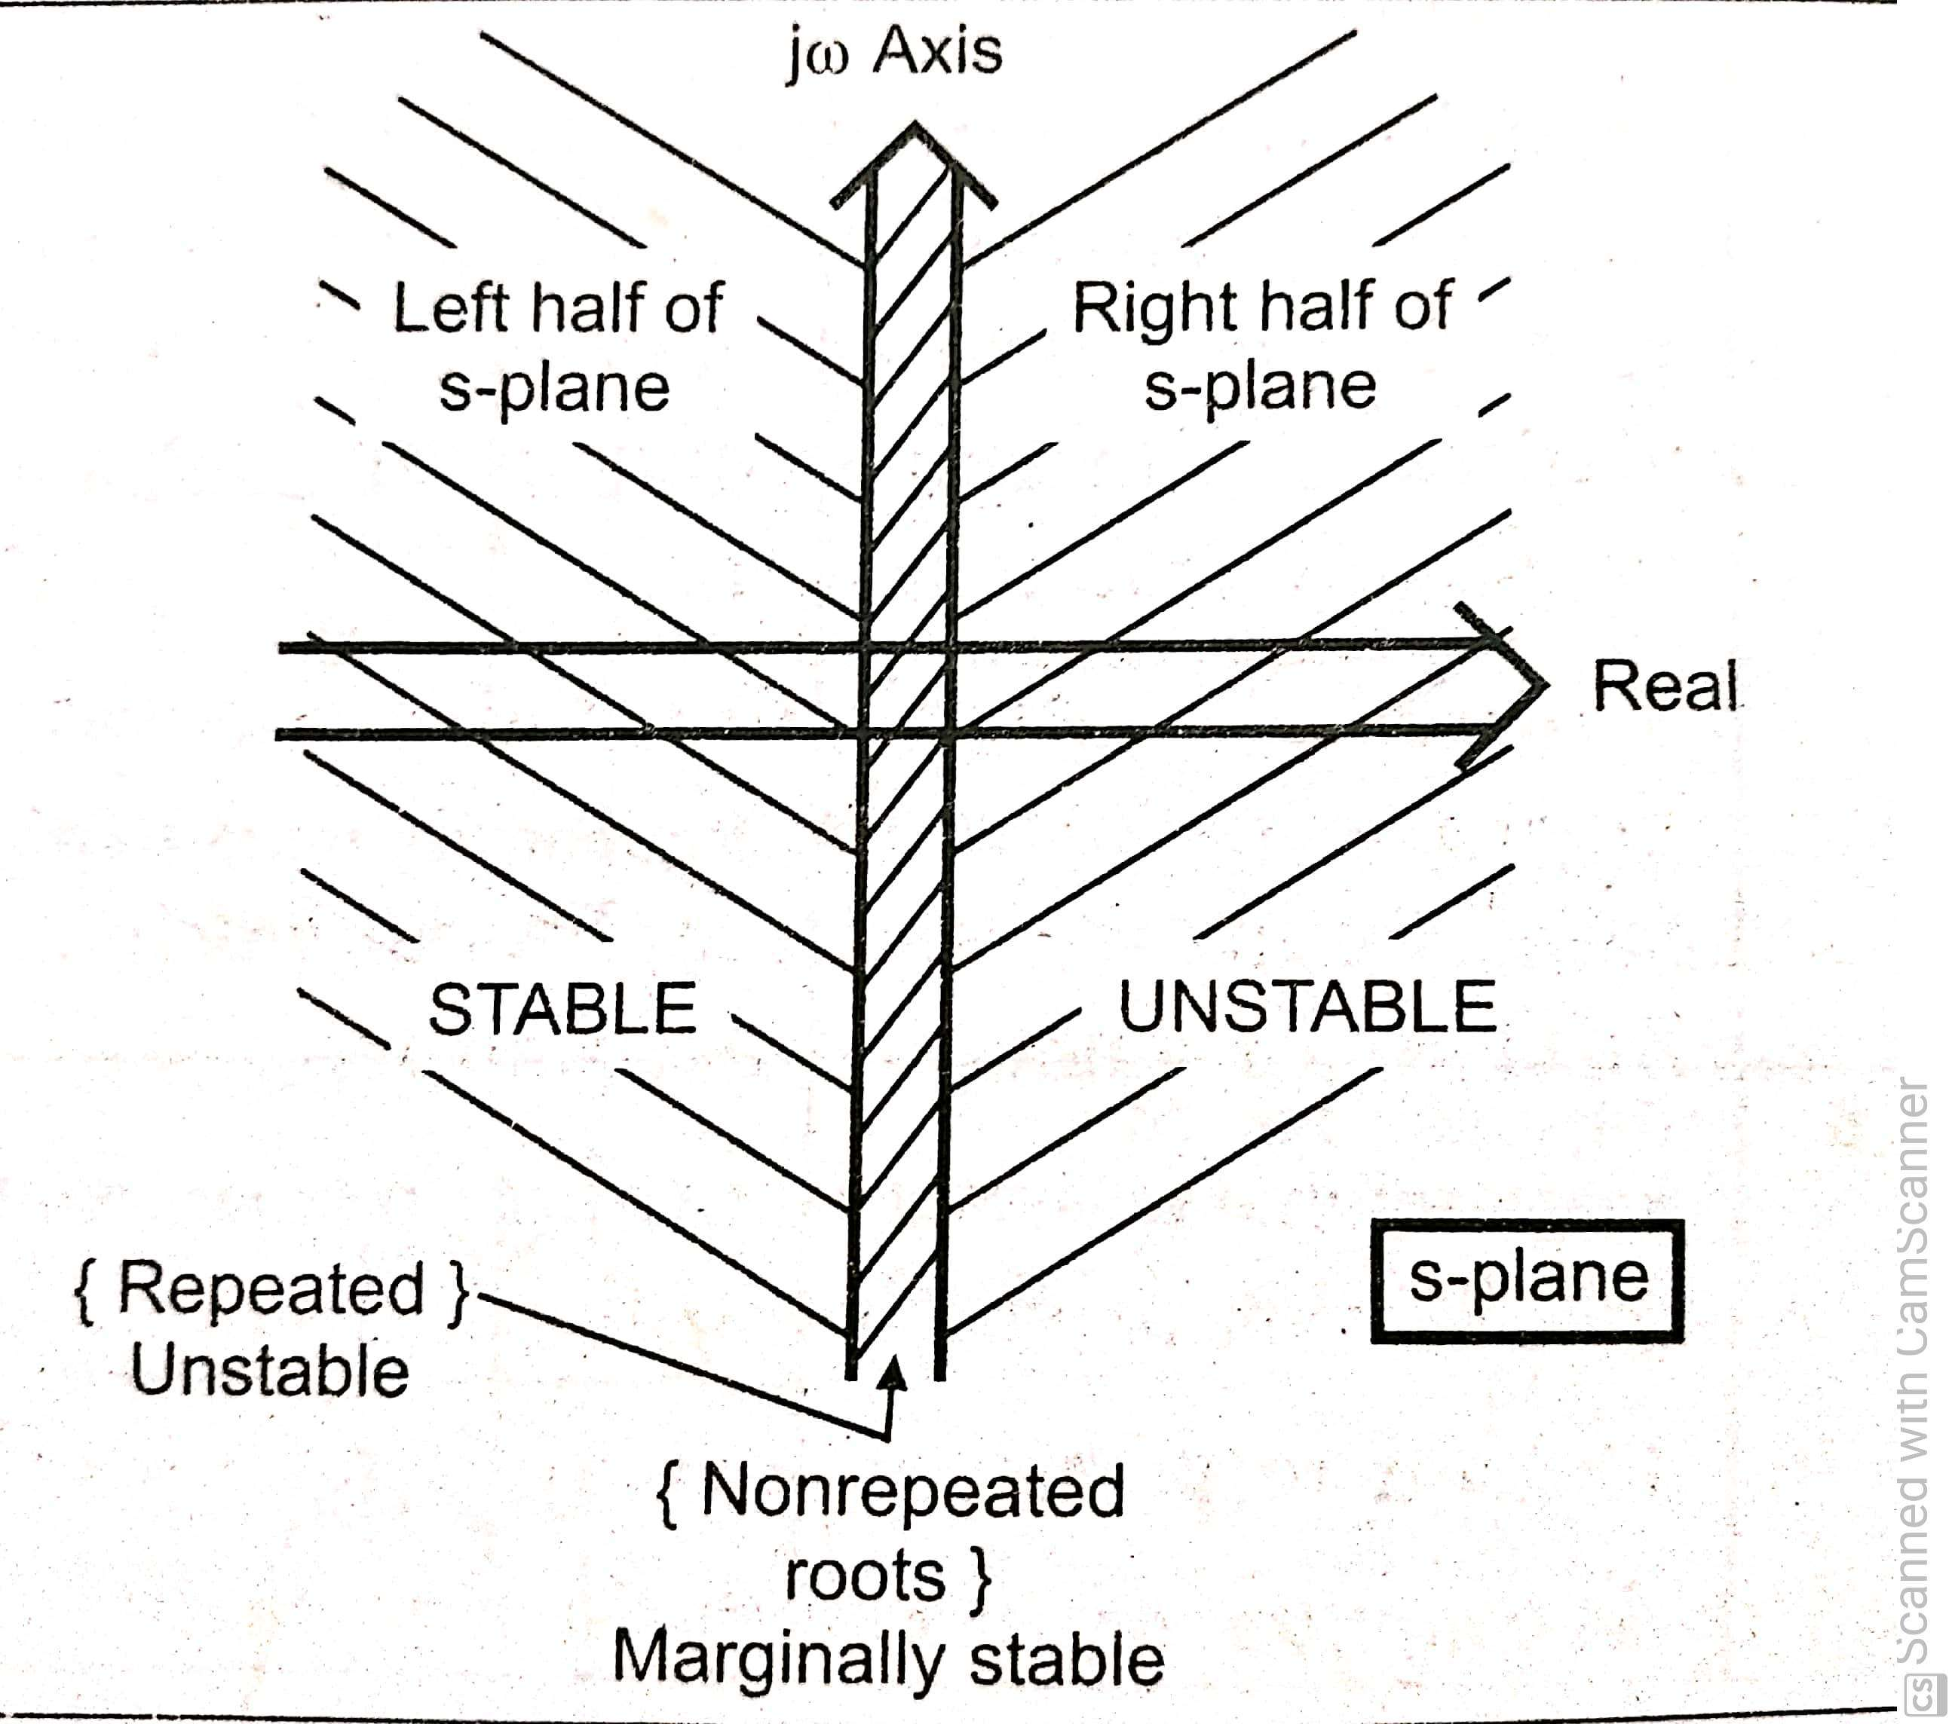

Slide 28
Stability
Routh’s Stability Criterion
Routh’s Stability Criterion : Different cases and conditions
Statement Method
Numericals Problems
28

Slide 29
Routh’s Stability Criterion
For the transfer function;
m m−1
C(s) ₌ b0 s + b1s
R(s) a0 s^{n} + a1s^{n−1}
+ ............... + bm
+ ............... + an
In this criterion, the coefficients of denominator are arranged in an Array called “Routh’s Array”;
a0s^{n} + a1s^{n−1} + ............... + an = 0

Slide 30
Stability
If all the roots of characteristics equation have negative real parts the system is stable
If any root of characteristics equation have positive real parts the system is Unstable
If condition 1 is satisfied except for the presence of one or more non repeated roots on jw axis the system is limitedly or critically or marginally stable
If one or more repeated roots on jw axis the system is Unstable

Slide 31
Stability
Absolute stable system: stable for all value of its parameters
Conditionally stable system: stable for certain bounded range of values of its parameters

Slide 32
Necessary (but not sufficient) condition for Stability
If all the coefficients of characteristics equation q(s)=0, be real and have the same sign furthermore none of the coefficients should be zero,
a0 >0
a0 s^{n} + a1s^{n−1}
+ ............... + an=0
furthermore none of the coefficients should be zero or negative unless, one (or more than one) conditions occurs
One or more roots have positive real parts
A root or roots are at origins ( hence an=0)
Presence of roots at jw axis

Slide 35
We therefore conclude that absence or negativeness of any of the coefficients of characteristics (with a0>0) indicates that the system is either unstable or limitedly stable
The first step of stability is to analyze the q(s)=0, if some of the coefficients are zero or negative it can be concluded that system is not stable
on the other hand if all of the coefficients are positive (or negative) the possibility of stability of system exists and one should further to examine the sufficient conditions of stability using Routh’ s stability criterion,

Slide 36
The coefficients of s^{n}and s^{n−1} row are directly written from the given equation.
Characteristics equation q(s) is given as
q(s)=a0s^{n} + a1s^{n−1} + ............... + an = 0
The Routh’s array as below;
For next row i.e. s^{n−2} ;
a 0 a2
a1 a3
a 4
a5
_{s}n
_{s}n−1
_{s}n−2
_{s}n−3
a6
a7
a1.a2 − a3a0
b1 =
a1
b1
_{s}0

Slide 37
The coefficients of s^{n} and s^{n−1} row are directly written from the given equation.
a0s^{n} + a1s^{n−1} + ............... + an = 0
For next row i.e. s^{n−2} ;
_{b1 =} a1.a2 − a3a0
The Routh’s array as below;
a 0 a2 a 4 a6
a1 a3 a5 a7
a1
_{s}n
_{s}n−1
_{s}n−2
_{s}n−3
a1.a4 − a0.a5
a1
b2 =
b1
b2
_{s}0

Slide 38
The coefficients of
_{s}n
and s^{n−1} row are directly written from the given equation.
a0s^{n} + a1s^{n−1} + ............... + an = 0
For next row i.e. s^{n−2} ;
_{b1 =} a1.a2 − a3a0
The Routh’s array as below;
a 0 a2
a1 a3
a 4
a5
b2 b3
a1
_{s}n
_{s}n−1
_{s}n−2
_{s}n−3
a6
a7
a1.a4 − a .0 a5
b2 =
a1
b1
a1.a6 − a0.a7
b3 =
a1
_{s}0

Slide 39
Now the same technique is used, for the next row i.e. s^{n−3} row, but
_{s}n−1
_{s}n−2
only previous two rows are used i.e. and
For next row i.e. s^{n−2} ;
The Routh’s array as below;
a1.a2 − a3a0
b1 =
a1
a1.a4 − a0.a5
a 0 a2
a1 a3
a 4
a5
b2 b3
_{s}n
_{s}n−1
_{s}n−2
_{s}n−3
a6
a7
b2 =
a1
a1.a6 − a0.a7
b3 =
b1
c1
a1
For next row i.e. s
n−3
;
b1.a3 − b2a1
c1 =
b1
_{s}0

Slide 40
Now the same technique is used, for the next row i.e. s^{n−3}row, but
_{s}n−1
_{s}n−2
only previous two rows are used i.e. and
For next row i.e. s^{n−2} ;
The Routh’s array as below;
a1.a2 − a3a0
b1 =
a1
a1.a4 − a0.a5
a 0 a2
a1 a3
a 4
a5
b2 b3
c2
_{s}n
_{s}n−1
_{s}n−2
_{s}n−3
a6
a7
b2 =
a1
a1.a6 − a0.a7
b3 =
b1
c1
a1
For next row i.e. s
n−3
;
b1.a3 − b2a1
b1
c1 =
_{s}0
_{c2 =} b1.a5 − b3a1
b1
34

Slide 41
Each column will reduce by one as we move down the array.
a 0 a2
a1 a3
_{s}n
_{s}n−1
_{s}n−2
_{s}n−3
a 4
a5
b2 b3
c2
a6
a7
b1
c1
This process is obtained till last row is obtained.
_{s}0
an

Slide 42
Routh’s Criterion
Must have same sign
The necessary & sufficient conditions for a system to be stable is all terms in the
a 0 a2
a1 a3
a 4
a5
b2 b3
c2
_{s}n
_{s}n−1
_{s}n−2
_{s}n−3
a6
a7
first Array sign.
column at Routh’s should have same
b1
c1
There should not be any sign change in first column.
_{s}0
an

Slide 43
Routh’s Criterion
When there are sign changes in the first column of Routh’s array then the system is unstable.
There are roots in RHP.
+ a 0 a2
₊ a1 a3
- b1
+ c1
a 4
a5
b2 b3
c2
_{s}n
_{s}n−1
_{s}n−2
_{s}n−3
a6
a7
The number of sign changes equal the number of roots in RHP.
_{s}0
an

Slide 44
Example 1
_{s}3
a 0
+ 6s² + 12s + 8 = 0
a1 a2 a3
_{s}3
1
12
_{s}2
6
b1
an
8
b2
_{s}1
_{s}0

Slide 45
Example 1
cont……
_{s}3
1
12
a1.a2 − a3.a0
b1 =
_{s}2
a1
6
b1
an
8
b2
_{s}1
_{s}0

Slide 46
Example 1
cont……
_{s}3
1
12
_{b1 =} (6 ×12) − (8×1)
_{s}2
6
6
b1
an
8
b2
_{s}1
_{s}0

Slide 47
Example 1
cont……
_{s}3
1
12
0
_{s}2
6
8
b2
0
_{s}1
_{s}0
10.67
an
a1.a4 − a0.a5
b2 =
a1

Slide 48
Example 1
cont……
_{s}3
1
12
0
_{s}2
6
8
b2
0
_{s}1
_{s}0
10.67
an
1× 0 − 6 × 0
b2 =
6

Slide 49
Example 1
cont……
_{s}3
1
12
0
_{s}2
6
8
0
_{s}1
_{s}0
10.67
0
an
10.67 × 8 − 6 × 0
b2 =
10.67

Slide 50
Example 1
cont……
_{s}3
+ 6s²
+ 12s + 8 = 0
_{s}3
1
12
0
_{s}2
6
8
0
_{s}1
_{s}0
10.67
0
8

Slide 51
Example 1
cont……
Elements in first column are of same sign
1 | 12 | 0
6 | 8 | 0
10.67 | 0
8
_{s}3
_{s}2
_{s}1
_{s}0
As all elements in first column are of same sign. Hence system is stable

Slide 52
Example 2
Comment on stability.
s⁴ + 2s³ + 6s² +10s + 3 = 0
_{s}4
1
2
6
10
3
0
a1.a2 − a3.a0
b1 =
_{s}3
a1
_{s}2
_{s}1
b1
b2
(2 × 6) − (1×10)
b1 =
2
c1
_{s}0
an
b1 = 1

Slide 53
Example 2
cont….
_{s}4
1
2
6
10
3
0
a1.a4 − a0.a5
b2 =
a1
_{s}3
_{s}2
_{s}1
_{b2 =} 2 × 3 −1× 0
1
c1
b2
2
_{s}0
an
b2 = 3

Slide 54
Example 2
cont….
b1.a3 − b2a1
_{s}4
1
2
6
10
c1 =
3
0
b1
_{s}3
1×10 − 2 × 3
_{s}2
_{s}1
c1 =
1
c1
3
1
_{s}0
an
c1 = 4

Slide 55
Example 2
cont….
c1.b 2 − b1c2
_{s}4
1
2
6
10
an =
3
0
c1
_{s}3
4 × 3 −1× 0
_{s}2
_{s}1
an =
1
3
4
4
an
_{s}0
an = 3

Slide 56
Example 2
cont….
_{s}4
1
2
6
10
3
0
As no sign change in first column; system is stable
_{s}3
_{s}2
_{s}1
1
3
4
3
_{s}0

Slide 57
Example 3
Comment on stability.
2s³ + 4s² + 4s +12 = 0
_{s}3
2
4
a1.a2 − a3.a0
0
b1 =
a1
_{s}2
_{s}1
12
4
b1
an
_{b1 =} (4 × 4) − (2 ×12)
b2
4
_{s}0
b1 = −2

Slide 58
Example 3
cont….
_{s}3
2
4
0
(4 × 0) − (2 × 0)
b2 =
_{s}2
_{s}1
4
4
−2
an
12
b2
b2 = 0
_{s}0

Slide 59
Example 3
cont….
_{s}3
2
4
0
(−2 ×12) − (4 × 0)
an =
_{s}2
_{s}1
−2
4
−2
an
12
0
an = 12
_{s}0

Slide 60
Example 3
cont….
_{s}3
2
4
0
_{s}2
_{s}1
12
4
−2
There are two sign changes
+4 to -2 and -2 to +12. Hence two roots are in RHP
S-plane and system is unstable
0
_{s}0
12

Slide 61
Example 4
Comment on stability.
s⁵ + 2s⁴ + 4s³ + 6s² + 2s + 5 = 0
_{b1 =} (2 × 4) − (6 ×1)
2
b1 = 1
_{b2 =} (2 × 2) − (5×1)
2
b2 = −0.5
_{s}5
_{s}4
_{s}3
_{s}2
_{s}1
1 | 4 | 2
2 | 6 | 5
b1 | b2
c1 d1 | c 2
_{s}0
an

Slide 62
Example 4
cont…..
_{c1 =} (1× 6) − (−0.5× 2)
_{s}5
_{s}4
1
2
4
6
−0.5
2
5
1
c1 = 7
_{s}3
1
(1× 5) − (0 × 2)
_{s}2
_{s}1
c1 c 2
d1
an
c2 =
1
c2 = 5
_{s}0

Slide 63
Example 4
cont…..
_{s}5
_{s}4
1
2
4
6
−0.5
2
5
(7 × −0.5) − (5×1)
d1 =
7
_{s}3
1
7
d1
an
d1 = −1.21
_{s}2
_{s}1
5
_{s}0

Slide 64
Example 4
cont…..
_{s}5
_{s}4
1
2
4
6
−0.5
2
5
(5× −1.21) − (7 × 0)
an =
−1.21
_{s}3
1
an = 5
_{s}2
_{s}1
7
−1.21
an
5
_{s}0

Slide 65
Example 4
cont…..
_{s}5
_{s}4
1
2
4
6
−0.5
2
5
There are two sign changes
+7 to -1.21 and -1.21 to +5.
Hence two roots are in RHP
S-plane and system is unstable
_{s}3
1
_{s}2
_{s}1
7
−1.21
5
_{s}0
5

Slide 66
Example 5
Comment on stability.
s⁵ + s⁴ + 2s³ + 2s² + 3s + 5 = 0
_{b1 =} (1× 2) − (2×1)
1
b1 = 0
_{b2 =} (1× 3) − (5×1)
1
b2 = −2
_{s}5
_{s}4
_{s}3
_{s}2
_{s}1
1 | 2 | 3
1 | 2 | 5
b1 | b2
c1 d1 | c 2
_{s}0
an

Slide 67
Example 5
cont…..
Comment on stability.
s⁵ + s⁴ + 2s³ + 2s² + 3s + 5 = 0
_{s}5
_{s}4
_{s}3
1 | 2 | 3
1 | 2 | 5
0 | −2
c1 | c 2
_{s}2
_{s}1
d1
an
Case I – “When the first element of any row is zero and the rest of the row is non-zero.”
_{s}0

Slide 68
Routh’s Criterion Special Cases
Case I – “When the first element of any row is zero and the rest of the row is non-zero.” Here the next row cannot be formed as division by 0 will take place.
Method to Overcome: A method to overcome above problem is to replace s by 1/Z and complete the Routh’s test
or replace 0 with small positive number ϵ and continue. Then examine the sign of first column by putting ϵ

Slide 69
Example 5
cont…..
Comment on stability.
s⁵ + s⁴ + 2s³ + 2s² + 3s + 5 = 0
_{s}5
_{s}4
_{s}3
1 | 2 | 3
1 | 2 | 5
ϵ | −2
c1 | c 2
_{s}2
_{s}1
d1
an
_{s}0

Slide 70
Example 5
cont…..
Replace s by (1/z)
1 1
1
1
1
5 4 3 2
( ) + ( ) + 2( ) + 2( ) + 3( ) + 5 = 0
z
z
z
z
z
Take L.C.M
1 + z + 2z ² + 2z³ + 3z ⁴ + 5z⁵
_{z}5
= 0
1+ z + 2z² + 2z³ + 3z⁴ + 5z⁵ = 0
5z⁵ + 3z⁴ + 2z³ + 2z² + z +1 = 0
Use above characteristics equation and complete Routh’s Test

Slide 71
Example 5
cont…..
_{z}5
5
2
1
1
_{z}4
3
2
4
3
2
3
_{z}3
−
−
There are two sign changes in first column.
Hence two roots are in RHP
S-plane and system is unstable
1
_{z}2
2
2
1
1
_{z}1 _{z}0

Slide 72
Example 6
Comment on stability.
s⁴ + 6s³ +11s² + 6s +10 = 0
_{b1 =} (6 ×11) − (1× 6)
6
_{s}4
1
6
11
6
10
0
_{s}3
b1 = 10
_{s}2
b1
b2
_{b2 =} (6 ×10) − (1× 0)
6
s
1
c1
_{s}0
an
b1 = 10

Slide 73
Example 6
cont….
_{c1 =} (10 × 6) − (10 × 6)
10
_{s}4
1
6
11
6
10
0
_{s}3
c1 = 0
_{s}2
_{s}1
10
10
c1
_{s}0
an

Slide 74
Example 6
cont….
_{c1 =} (10 × 6) − (10 × 6)
10
_{s}4
1
6
11
6
10
0
_{s}3
c1 = 0
_{s}2
_{s}1
10
10
0
an
_{s}0
Case II – “When all elements in any one row is zero.”

Slide 75
Routh’s Criterion Special Cases
Case II – “When all elements in any one row is zero.”
Method to Overcome:
Here form an auxillary equation with the help of the coefficients of the coefficients of the row just above the row of zeros( order of aux eq is
always even).
Take the derivative of this equation and replace it’s coefficients in the present row of zeros.
Then proceed for Routh’s test.

Slide 76
Stability
Difficulty II indicate there are symmetrically located roots in the s-plane
Pairs of real roots with opposite signs
Pairs of conjugates roots
on imaginary axis
Pairs of conjugates roots forming
Quadrature in s plane

Slide 77
Example 6
cont….
Here s¹ row breaks down. Hence write auxiliary equation for s² .
A(s) = 10s² +10
(Note each term of next column differs by degree of 2)
_{s}4
1
6
11
6
10
0
_{s}3
_{s}2
_{s}1
10
10
0
an
Take derivative of auxiliary equation
_{s}0
^{d} A(s) = 20s
ds
Use these for s row coefficients.

Slide 78
Example 6
cont….
_{s}4
1
6
11
6
10
0
_{an =} (20 ×10) − (10 × 0)
20
an = 10
s
3
_{s}2
_{s}1
10
10
20
an
_{s}0

Slide 79
Example 6
cont….
_{s}4
1
6
11
6
10
0
As no sign change in first column; system is stable
_{s}3
_{s}2
_{s}1
10
10
20
10
_{s}0

Slide 80
Example 7
Comment on stability.
s⁶ + 3s⁵ + 5s⁴ + 9s³ + 8s² + 6s + 4 = 0
(3× 5) − (9 ×1) 3
_{s}6
_{s}5
_{s}4
¹ 5 8
3 9 6
b1 b2 b3
4
b1 =
b1 = 2
_{b2 =} (3× 8) − (6 ×1)
c1 c 2
d1
e1
an
3
b2 = 6
_{s}3
_{s}2 _{s}1 _{s}0
(3× 4) − (0 ×1) 3
b3 = 4
b3 =

Slide 81
Example 7
cont….
_{s}6
_{s}5
_{s}4
1 | 5 | 8 | 4
3 | 9 | 6
2 | 6 | 4
c1 | c 2
d1
(2 × 9) − (3× 6)
c1 =
2
c1 = 0
_{s}3
_{s}2 _{s}1 _{s}0
_{c2 =} (2 × 6) − (4 × 3)
2
e1
an
c2 = 0

Slide 82
Example 7
cont….
_{s}6
_{s}5
_{s}4
1
3
2
5
9
6
8
6
4
Here s³ row breaks down. Hence write auxiliary equation for s⁴ .
A(s) = 2s⁴ + 6s² + 4
(Note each term of next column
differs by degree of 2)
4
_{s}3
_{s}2 _{s}1 _{s}0
0
d1
e1
an
0
Take derivative of auxiliary equation
^{d} A(s) = 8s³ + 12s
ds
Use these for s³ row coefficients.

Slide 83
Example 7
cont….
_{s}6
_{s}5
_{s}4
1 | 5 | 8 | 4
3 | 9 | 6
2 | 6 | 4
8 | 12
d1 | d 2
e1 an
(8× 6) − (12 × 2)
d1 =
8
d1 = 3
_{s}3
_{s}2 _{s}1 _{s}0
(8× 4) − (0 × 2)
d 2 =
8
d 2 = 4

Slide 84
Example 7
cont….
_{s}6
_{s}5
_{s}4
1 | 5 | 8 | 4
3 | 9 | 6
2 | 6 | 4
8 | 12
3 | 4
_{e1 =} (3×12) − (8× 4)
3
_{s}3
_{s}2 _{s}1 _{s}0
e1 = 4
e1
an

Slide 85
Example 7
cont….
_{s}6
_{s}5
_{s}4
1 | 5 | 8 | 4
3 | 9 | 6
2 | 6 | 4
8 | 12
3 | 4
_{an =} (4 × 4) − (3× 0)
4
_{s}3
_{s}2 _{s}1 _{s}0
an = 4
4
an

Slide 86
Example 7
cont….
As no sign change in first column; system is stable
_{s}6
_{s}5
_{s}4
1 | 5 | 8 | 4
3 | 9 | 6
2 | 6 | 4
8 | 12
3 | 4
4
4
_{s}3
_{s}2 _{s}1 _{s}0

Slide 88
Example 8
Comment on stability.
s⁶ + 2s⁵ + 8s⁴ +12s³ + 20s² +16s +16 = 0
_{s}6
_{s}5
_{s}4
(2 × 8) − (12 ×1)
1 | 8 | 20 16
2 | 12 | 16
b1 | b2 | b3
c1 | c 2
d1
b1 =
2
b1 = 2
_{b2 =} (2 × 20) − (16 ×1)
_{s}3
_{s}2 _{s}1 _{s}0
2
b2 = 12
e1
an
(2 ×16) − (0 ×1)
b3 =
2
b3 = 16

Slide 89
Example 8
cont…..
_{c1 =} (2 ×12) − (2 ×12)
_{s}6
_{s}5
_{s}4
2
1 | 8 | 20 | 16
2 | 12 | 16
2 | 12 | 16
c1 | c 2 | c3
d1
c1 = 0
(2×16) − (2×16)
c2 =
_{s}3
_{s}2
_{s}1
2
c2 = 0
e1
an
_{c3 =} (2 × 0) − (2 × 0)
2
s
0
c3 = 0
8/30/2016
Nevase Amit
80

Slide 90
Example 8
cont…..
_{s}6
_{s}5
_{s}4
Here s³ row breaks down. Hence write auxiliary equation for s⁴ .
A(s) = 2 s⁴ + 12 s² + 16
(Note each term of next column differs by degree of 2)
1 | 8 | 20 | 16
2 | 12 | 16
2 | 12 | 16
0 d1 | 0 | 0
_{s}3
_{s}2 _{s}1 _{s}0
Take derivative of auxiliary equation
e1
an
^{d} A(s) = 8s³ + 24s
ds
Use these for s³ row coefficients.

Slide 91
Example 8
cont…..
_{s}6
_{s}5
_{s}4
1
2
2
8 20
12 16
12 16
(8×12) − (24 × 2)
16
d1 =
8
d1 = 6
_{s}3
_{s}2 _{s}1 _{s}0
8
d1
e1
an
24
d 2
0
(8×16) − (0 × 2)
d 2 =
8
d 2 = 16

Slide 92
Example 8
cont…..
_{s}6
_{s}5
_{s}4
1 | 8 | 20 | 16
2 | 12 | 16
2 | 12 | 16
8 | 24 | 0
6 | 16
e1 an
(6 × 24) − (8×16)
e1 =
6
_{s}3
_{s}2 _{s}1 _{s}0
e1 = 2.67

Slide 93
Example 8
cont…..
_{s}6
_{s}5
_{s}4
1 | 8 | 20 | 16
2 | 12 | 16
2 | 12 | 16
8 | 24 | 0
6 | 16
_{an =} (2.67 ×16) − (6 × 0)
2.67
_{s}3
_{s}2 _{s}1 _{s}0
an = 16
2.67
an

Slide 94
Example 8
cont…..
_{s}6
_{s}5
_{s}4
1 | 8 | 20 | 16
2 | 12 | 16
2 | 12 | 16
8 | 24 | 0
6 | 16
2.67
16
As no sign change in first column; system is stable
_{s}3
_{s}2 _{s}1 _{s}0

Slide 96
Example 9
Problem: Using routh’s criteria find the stability for given figure.
100
s² + 10s
R(s)
+
C(s)
-

Slide 97
Example 9
cont……
100
G(s) =
H(s) = 1
_{s}2
+ 10s
∴ C(s) ₌
G(s)
R(s)
1 + G(s)H (s)
100
100
∴ C(s) ₌
_{s}2
+ 10s
_{s}2
100
=
+ 10s
=
R(s)
100
_{s}2
_{s}2
+ 10s + 100
+ 10s + 100
1 +
_{s}2
+ 10s
_{s}2
+ 10s
Characteristics equation is the denominator of the CLTF
Characteristics equation
_{s}2
+10s +100 = 0

Slide 98
Example 9
cont…….
_{s}2
+10s +100 = 0
_{s}2
100
1
_{an =} (10 ×100) − (1× 0)
_{s}1
10
10
an = 100
_{s}0
an

Slide 99
Example 9
cont…….
_{s}2
+10s +100 = 0
_{s}2
100
1
_{s}1
As no sign change in first
column; system is stable
10
_{s}0
100

Slide 100
Example 10
Comment on stability.
s⁶ + 3s⁵ + 4s⁴ + 6s³ + 5s² + 3s + 2 = 0
_{s}6
_{s}5
1 | 4 | 5 2
3 | 6 | 3
b | b2 | b3
c | c 2
d1
(3× 4) − (1× 6)
b1 =
3
b1 = 2
_{b2 =} (3× 5) − (1× 3)
3
b2 = 4
s
4
1
s
3
1
_{s}2 _{s}1 _{s}0
e1
an
(3× 2) − (0 ×1)
b3 =
3
b3 = 2

Slide 101
Example 10
cont……
_{c1 =} (2 × 6) − (3× 4)
_{s}6
_{s}5
_{s}4
1 ₄
3 6
2 4
c1 c 2
d1
e1
an
5
3
2
c3
2
2
c1 = 0
_{c2 =} (2 × 3) − (2 × 3)
_{s}3
_{s}2 _{s}1 _{s}0
2
c2 = 0
(2 × 0) − (2 × 0)
c3 =
2
c3 = 0
8/30/2016
Nevase Amit
91

Slide 102
Example 10
cont……
Here s³ row breaks down. Hence write auxiliary equation for s⁴ .
A(s) = 2 s⁴ + 4s² + 2
_{s}6
_{s}5
_{s}4
1
3
2
5
3
2
4
6
4
2
A(s) = s⁴ + 2s² + 1
(Note each term of next column differs by degree of 2)
_{s}3
_{s}2 _{s}1 _{s}0
0
d1
e1
an
0
d 2
0
Take derivative of auxiliary equation
d
A(s) = 4 s³ + 4s
ds
Use these for s³ row coefficients.
102

Slide 103
Example 10
cont……
_{s}6
_{s}5
_{s}4
1
3
2
5
3
2
4
6
4
2
(4 × 4) − (4 × 2)
d1 =
4
_{s}3
_{s}2 _{s}1 _{s}0
4 4
d1 d 2
e1
an
d1 = 2
0
(4× 2) − (0× 2)
d 2 =
4
d 2 = 2
103

Slide 104
Example 10
cont……
_{s}6
_{s}5
_{s}4
1 | 4 | 5 | 2
3 | 6 | 3
2 | 4 | 2
4 | 4 | 0
2 | 2
e1 an | e2
_{e1 =} (2 × 4) − (2 × 4)
2
e1 = 0
_{s}3
_{s}2 _{s}1 _{s}0
_{e2 =} (2 × 0) − (0 × 4)
2
e2 = 0
104

Slide 105
Example 10
cont……
_{s}6
_{s}5
_{s}4
1 | 4 | 5 | 2
3 | 6 | 3
2 | 4 | 2
4 | 4 | 0
2 | 2
0 a | 0
Here s¹ row breaks down. Hence write auxiliary equation for s² .
A(s) = 2s² + 2
_{s}3
_{s}2
_{s}1
(Note each term of next column
differs by degree of 2)
Take derivative of auxiliary equation
0
^{d} A(s) = 4s ds
Use these for s¹ row coefficients.
s
n
105

Slide 106
Example 10
cont……
_{s}6
_{s}5
_{s}4
1 | 4 | 5 | 2
3 | 6 | 3
2 | 4 | 2
4 | 4 | 0
2 | 2
4 an | 0
_{an =} (4 × 2) − (2 × 0)
4
_{s}3
_{s}2 _{s}1 _{s}0
an = 2
106

Slide 107
Example 10
cont……
_{s}6
_{s}5
_{s}4
1 | 4 | 5 | 2
3 | 6 | 3
2 | 4 | 2
4 | 4 | 0
2 | 2
4 | 0
2
As no sign change in first
column; system is stable
_{s}3
_{s}2 _{s}1 _{s}0
107

Slide 108
Application of Routh’s Criterion
The gain is kept in terms of k and Routh’s array is solved to find k for stable operation.
108

Slide 109
Example 11
Determine the range of k for stable system.
s⁴ + 5s³ + 5s² + 4s + k = 0
_{s}4
1
5
k
_{s}3
5
4
0
_{s}2
4.2
16.8 − 5k
k
_{s}1
4.2
_{s}0
k
109

Slide 110
Example 11 cont……
For stability all elements of first column 1 should be positive
For s⁰ row For s¹ row
i.e.
k > 0
16.8 − 5k _{> 0}
------------------(1)
and
4.2
16.8 > 5k or k<
16.8
i.e.
5
k < 3.36
Thus combining equations (1) and (2),
-----------------(2)
0 < k < 3.36
This is the range of k stable operation.
110

Slide 111
Example 12
Determine the range of k for stable system.
s⁴ + 4s³ + 4s² + 3s + k = 0
_{s}4
1
4
k
_{s}3
4
13
3
0
_{s}2
4
39 −16k
k
_{s}1
13
_{s}0
k
111

Slide 112
Example 12
cont……
For stability,
39 −16k
i.e.
k > 0
and
> 0
13
39
i.e.
39 −16k > 0 or k<
k < 2.43
16
Thus
0 < k < 2.43
This is the range of k stable operation.
112

Slide 113
Example 13
Determine the range of k for stable system. _{s}³ _{+ s}² _{(2 + k) + 30sk + 200k = 0}
_{s}3
1
30k
_{s}2
2 + k
200k
_{s}1
30k(2 + k) − 200k
(2 + k)
_{s}0
k
113

Slide 114
Example 13
cont……
For stability,
k > 0
k + 2 > 0
k > −2
i.e.
i.e.
and
30k(k + 2) − 200k _{> 0}
2 + k
k > 4.67
Thus
4.67 < k < ∞
This is the range of k stable operation.
114

Slide 115
Advantages of Routh’s Criterion
It is a simple algebraic method to determine the stability of closed loop without solving for roots of higher order polynomial of the characteristics equation.
It is not tedious or time consuming.
It progress systematically.
It is frequently used to determine absolute & relative stability of a system.
the conditions of
It can determine range of k for stable operation.
115

Slide 116
Disadvantages of Routh’s Criterion
It is valid only for real coefficients of characteristics equation. Any coefficient that is a complex number or contains exponential factors, the test fails.
It is applicable only to the linear systems.
Exact location of poles is not known.
Only idea is obtained about stability. A method to stabilize the system is not suggested.
116

Slide 117

References
Control System Engineering
J. J. Nagrath, M. Gopal
Modern control Engineering
- K. Ogata

